Slide 1
Statistics, an unreliable friend
Malta Data Saturday 0006 2021-04-24 Magnus Ahlkvist

Slide 2

Magnus Ahlkvist
Database consultant
Transmokopter SQL AB
Data Platform MVP
Microsoft Certified Trainer
Community organiser
SQL Friday – https://sqlfriday.net – Free Data Platform training every week
SQL Server Usergroup Sweden
www.tsql.nu
@transmokopter
/in/magnusahlkvist
magnus@transmokopter.se
youtube.com/c/transmokopter

Slide 5
Background info about the presentation
Demos

Slide 6
Why this presentation
System for reporting financial statistics
Tight deadline
Bad performance on reporting day -> Reports were sent in after deadline -> European Central Bank unhappy -> DBA being yelled at -> DBA unhappy

Slide 7
Session demo scenario
Simplified order database

Slide 8
Problem specifics
Getting orders for yesterday and before -> Fast
Getting today’s orders -> Not fast

Slide 10
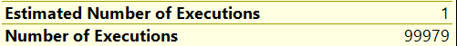
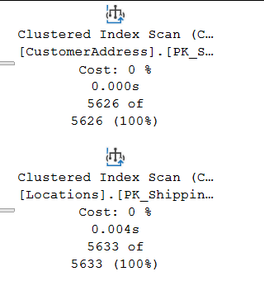
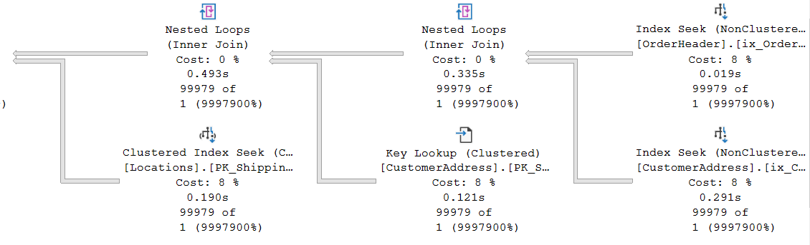
Some plan characteristics
OK
Awful

Slide 11
Statistics (or lies) in SQL Server
Distribution of values within an index or statistics object
Histogram or Density vector
DEMO

Slide 12
Statistics histogram
RANGE_HI_KEY | RANGE_ROWS | EQ_ROWS | DISTINCT_RANGE_ROWS | AVG_RANGE_ROWS
Upper limit of a bucket (sqlvariant). A distinct value from the leading column in the index/statistics object. | Number of rows in the bucket, between RANGE_HI_KEY and the previous RANGE_HI_KEY | Number of rows in the bucket with value exactly RANGE_HI_KEY | Number of unique values for the leading column of the index/statistics object in range between RANGE_HI_KEY and previous RANGE_HI_KEY | Average rows per distinct value between RANGE_HI_KEY and previous RANGE_HI_KEY

Slide 13
Statistics density vector
Density of leading column, then two leading columns in combination, then three leading columns…
Density = 1 / NoDistinctValues
Gender = High density, SSN = Low density
Low Selectivity = High Density

Slide 14
Estimated number of rows
With histogram
OrderDate = 2016-08-24: 12496
OrderDate = 2016-08-25: 0 (Optimizer will estimate 1)
With Density Vector
D = Density for column(s) involved in equality predicate.
Example: OrderDate = 2020-08-25. Density for OrderDate = 0,004
RC = Total number of rows in the table
Estimated number of rows for equality predicate: D * RC
2020-08-24: 0,004 x 3 124 374 = 12497
2020-08-25: 0,004 x 3 124 374 = 12497
Then came New Cardinality Estimation. More on that later…

Slide 15
Ascending Key Problem
Can also be missing key-in-the-middle problem
Can also be bad estimates even with perfect statistics ☹

Slide 16
Ok Magnus. It’s broken. Can we fix it?

Slide 17
Other causes of bad guessing on Optimizer part
Statistics updated with low sample rate and skewed data
Bad cardinality estimation due to complex predicate and join logic
SQL 2014 and later addresses Ascending Key (with varying success)
But introduce a new cardinality estimator
DEMO

Slide 18
SQL Server 2014
Ascending Key problem, kind of fixed. Use Density Vector when value is outside of the statistics Histogram. Sometimes. And sometimes use SQRT(Rowcount). Very confusing.
New Cardinality Estimation
Assume columns in the same table are related (BrandName related to ModelName and Color)
Assume non-join predicates in different tables are NOT related.
Same Auto Update Stats as ”always”:
20% of the rows have been changed (inserted, updated or deleted)
For our 5 million row table, that means 1 million rows
Traceflag 2371 changes behaviour

Slide 19
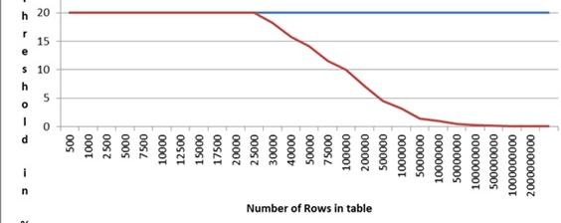


SQL Server 2016
Same cardinality estimation as SQL Server 2014
Auto Update Stats percent threshold gets lower as the table grows bigger
Up to 25k rows, 20% threshold is used
With more than 25k rows, threshold is dynamically decreased in relation to rowcount of table.
https://blogs.msdn.microsoft.com/saponsqlserver/2011/09/07/changes-to-automatic-update-statistics-in-sql-server-traceflag-2371/

Slide 20
Statistics are important
Even with good statistics – SQL Server Optimizer is not always a good statistician.
www.tsql.nu
/in/MagnusAhlkvist
magnus@transmokopter.se

